Slide 1
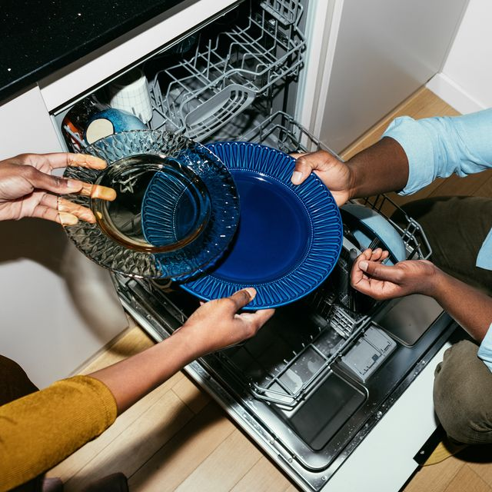
FILL IT,SHUT IT,FORGET IT
- LEAVE YOUR UNTIDY DISHES TO US

Slide 2
Objectives
Position dishwashers as household necessities akin to washing machines
Strategies Overview
- Rigorous six-month marketing campaign emphasizing benefits, social media engagement, product trials, and strategic partnerships.
Execution Strategies
Driving Adoption
Promotional Campaign:
Rigorous six-month marketing: Ads, banners, social media targeting evening viewers.
Continuous assessment for optimization.
Metrics: Track ad viewership, click through rates, social media engagement, and product inquiries.

Slide 3
2. Product Launch & Sales Approach:
launch a month before festivals, offering free trials and demos.
Sales focus on high-traffic areas highlighting functionalities.
Metrics: Conversion rates, foot traffic, and sales in targeted regions.
ENSURING LONG-TERM SUCCESS
Securing Adoption
Festival Season Offers:
Capitalize on festivals with attractive warranties, complimentary items, and emi options to boost sales and engagement.
Metrics : Compare sales during festivals, collect feedback.
2.Expansion & Post-Purchase Engagement:
Launch at head branch, expand through partnerships.
Post-purchase strategy for satisfaction and loyalty.
Metrics: Measure satisfaction scores, repeat purchases, and referrals.
THERE IS NO NEED OF MIRROR
BECAUSE YOU HAVE A DISH WASHER
THAT WASHES YOUR DISHES CRYSTAL CLEAR

